Slide 1

Minor Project Report on
Detection of 9 Varieties of Skin Cancer through Deep Learning-driven Image Modelling
By
Sanya Sinha (BTECH/15108/20)
Rohit Raj (BTECH/15138/20)
Ashwin Prakash Singh (BTECH/15202/20)
Under the Guidance of:
Dr. Shipra
DEPARTMENT OF ELECTRONICS & COMMUNICATION ENGINEERING
BIRLA INSTITUTE OF TECHNOLOGY MESRA, PATNA CAMPUS
BIHAR-800014, INDIA
1

Slide 2
Table of contents
Sl. no | Title | Slide no.
1 | Abstract | 3
2 | Introduction | 4
3 | Literature Survey | 5
4 | Dataset Used | 6
5 | Proposed Work | 7
6 | Results and Discussions | 8
7 | LIVE Demo | 10
8 | References | 11

Slide 3
Abstract
Skin cancer is a dangerous form of cancer caused by un-repaired DNA in skin cells, leading to genetic defects or mutations
Early detection is crucial for effective treatment of skin cancer. Skin cancer tends to spread gradually to other body parts.
The increasing rate of skin cancer cases, high mortality rate, and expensive medical treatment emphasize the importance of early diagnosis.
Our aim is to develop a deep learning-based data-driven to identify skin cancer in its early stages.
Keywords: computer vision, image processing, healthcare AI

Slide 4

Introduction
Perform image pre-processing and augmentation
Simulate model and interpret model outcomes
Deploy model results
Classify between 9 varieties of skin cancer
Create an image-based data-driven model
Propose a deep learning-based architecture

Slide 5
Literature Survey
S No. | Author(s) | Paper | Findings | Relevance to Project
1. | Khan M.Q., Hussain A., Rehman S.U., Khan U., Maqsood M., Mehmood K., Khan M.A | Classification of Melanoma and Nevus in Digital Images for Diagnosis of Skin Cancer. | Intelligent system to detect and distinguish melanoma from nevus by using the K-means clustering to extract the most suitable features, and compare the classification results with the other techniques present in the literature | Machine-learning based classification of skin lesions to indicate potential risk of 4 kinds of skin cancer.
2. | Esteva A., Kuprel B., Novoa R. | Dermatologist-level classification of skin cancer with deep neural networks | Automated classification of skin lesions using images through a convolutional neural network (CNN) | Introduced deep learning for binary skin lesion classification: malignant melanoma and benign nevi, and keratinocyte carcinomas versus benign seborrheic keratoses
3. | Brinker T.J., Hekler A., Enk A.H., Klode J., Hauschild A., et al. | A convolutional neural network trained with dermoscopic images performed on par with 145 dermatologists in a clinical melanoma image classification task | Describes a CNN model architectures that returns better binary classification diagnostic results than trained dermatologists. | Illustrated the efficiency of computer-aided diagnostic models for enhanced perception and speedy detection.
How to Classify 9 Varieties of Skin Cancer?

Slide 6
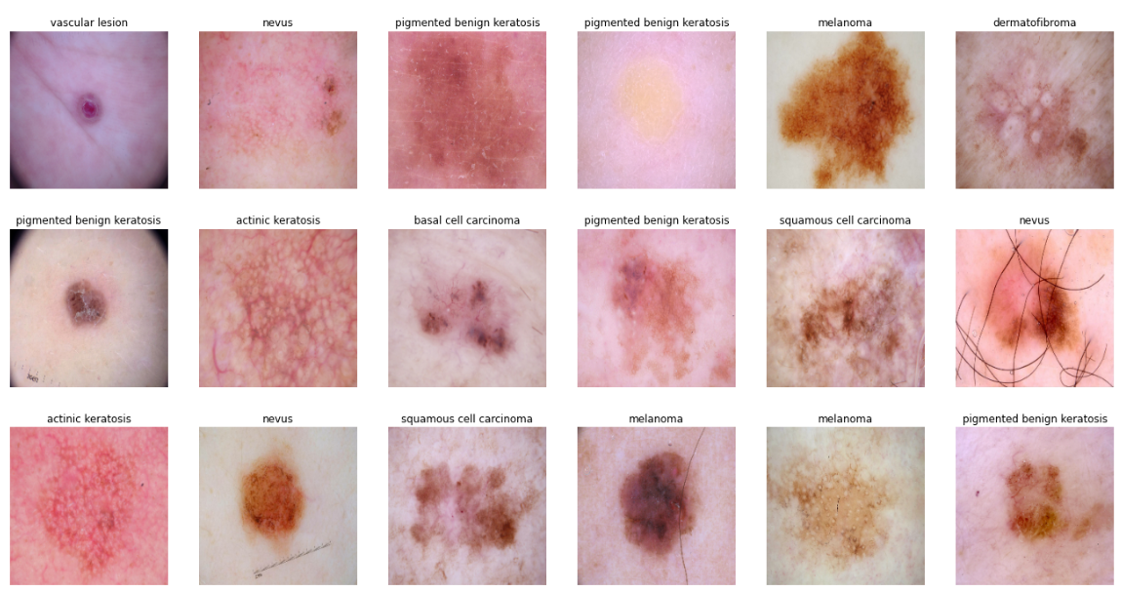
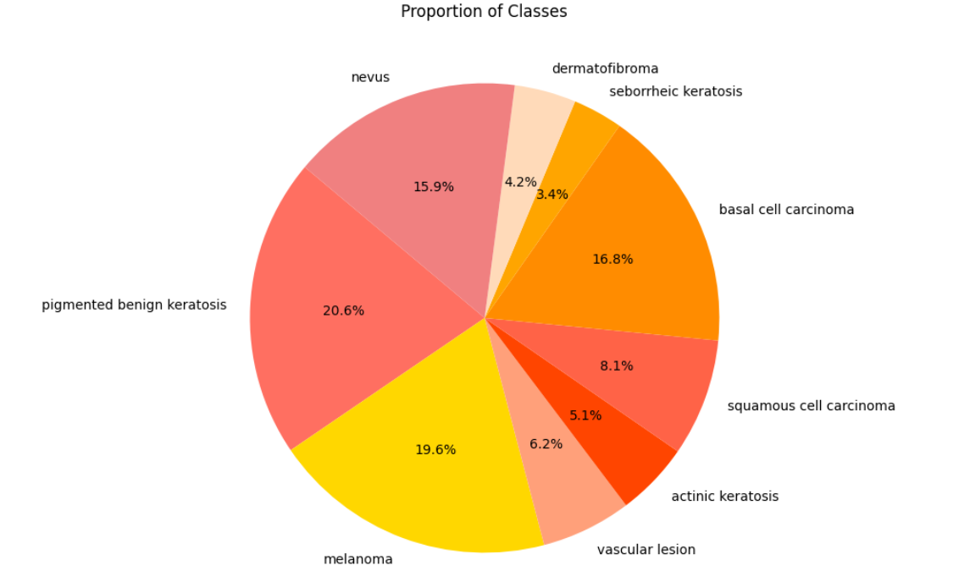
Dataset Used
ISIC 2018:2537 images

Slide 7

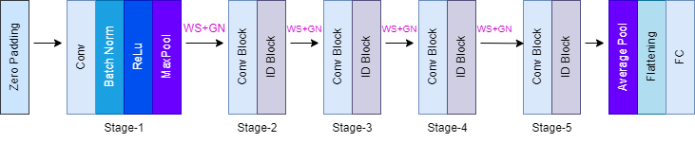
Proposed Work
BigTransfer (BiT) Architecture
Hyperrule-Specifications
Optimizer: SGD
Loss: Sparse Categorical Cross entropy
MixUp Regularization
Replace Batch Normalization with Weight Standardization and Group Normalization
Variant of ResNet architecture

Slide 8
Results and Discussions
Model Name | Inception V3 | VGG16 | ResNet50 | EfficientNetB0 | SVM | AdaBoost MC | BiT (Proposed)
Accuracy (%) | 84.43 | 84.24 | 76.70 | 54.77 | 77.65 | 79.92 | 88.13
Sensitivity (%) | 94.91 | 92.21 | 92.05 | 55.30 | 78.95 | 82.25 | 97.79
Specificity (%) | 96.65 | 89.85 | 92.05 | 55.30 | 77.63 | 79.39 | 99.39

Slide 9
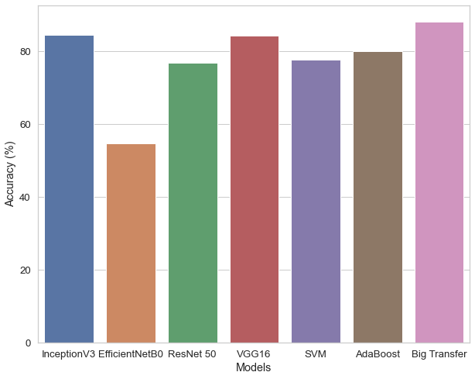
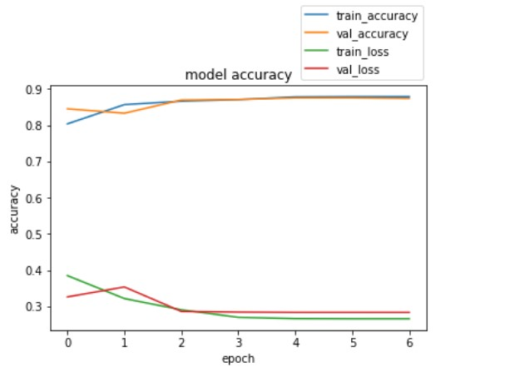
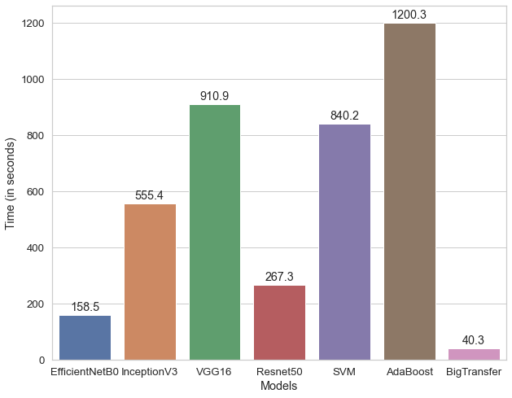
Results and Discussions
Fig.1. Top-1 Accuracies of Models
Fig.2. Accuracy and Loss Curves
Fig.3. Training Time of Models

Slide 10

LIVE Demo

Slide 11
References
1. Khan M.Q., Hussain A., Rehman S.U., Khan U., Maqsood M., Mehmood K., Khan M.A. Classification of Melanoma and Nevus in Digital Images for Diagnosis of Skin Cancer. IEEE Access. 2019;7:90132–90144.
2. A. Esteva et al., “Dermatologist-level classification of skin cancer with deep neural networks,” Nature, vol. 542, no. 7639, pp. 115–118, Feb. 2017.
3. T.J. Brinker, A. Hekler, A.H. Enk, J. Klode, A. Hauschild, C. Berking, B. Schilling, S. Haferkamp, D. Schadendorf, S. Frohling, et al., A convolutional neural network trained with dermoscopic images performed on par with 145 dermatologists in a clinical melanoma image classification task, Eur. J. Canc. 111 (2019) 148–154.
4. Ebtihal A, Arfan JM (2016) Classification of Dermoscopic skin cancer images using color and hybrid texture features. Int J Comput Sci Netw Secur 16(4):135–139
5. Isasi AG, Zapirain GB, Zorrilla MA (2011) Melanomas non-invasive diagnosis application based on the ABCD rule and pattern recognition image processing algorithms. Comput Biol Med 41:742–755
6. Miglani, V., Bhatia, M. (2021). Skin Lesion Classification: A Transfer Learning Approach Using EfficientNets. In: Hassanien, A., Bhatnagar, R., Darwish, A. (eds) Advanced Machine Learning Technologies and Applications. AMLTA 2020. Advances in Intelligent Systems and Computing, vol 1141. Springer, Singapore
7. Kolesnikov, Alexander & Beyer, Lucas & Zhai, Xiaohua & Puigcerver, Joan & Yung, Jessica & Gelly, Sylvain & Houlsby, Neil. (2020). Big Transfer (BiT): General Visual Representation Learning. 10.1007/978-3-030-58558-7_29.
https://make.powerapps.com/environments/Default-84c31ca0-ac3b-4eae-ad11-519d80233e6f/apps?utm_source=PAMarketing&utm_medium=header&utm_campaign=signin

Slide 12
Thank You!

